Slide 1
SEO Strategy for FlinkIt
- By Prince Mundiya

Slide 2
Home Page
Location selection prompt
Main search bar
Login
My Cart link
Featured Categories & Banners
Download App CTA
Footer links
Recipes / Bistro sections
See All Categories option
Major product categories: Groceries, Snacks,
Partner / Franchise / Seller / Warehouse /
Security Page
Terms & Conditions
Contact
Privacy Policy
FAQs
Blog
Sub Pages
Blog, Privacy Policy, Terms, FAQs
Security, Contact, Partner, Franchise, Seller registration
Recipes / Bistro
About Us (via parent site)

Slide 3
Product & Category Pages
Cart and Checkout flow
Product Detail Pages with description, price, and images
Category Listing Pages with filters
User Account / Login
User Dashboard / Profile
Login / Sign‑in page
Orders, Addresses, Payment Methods, Support, Settings
Support & Contact
Contact Page (Email, Phone, Chat)
FAQs
Security Page
Help Centre / My Orders tracking

Slide 4
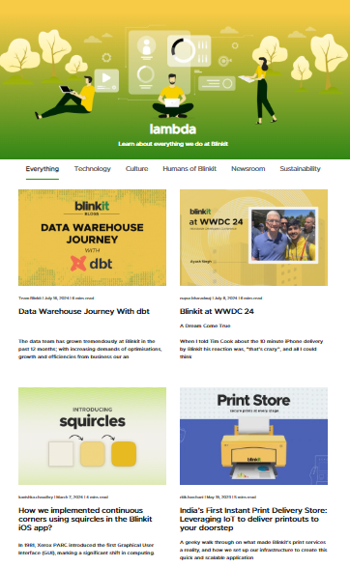
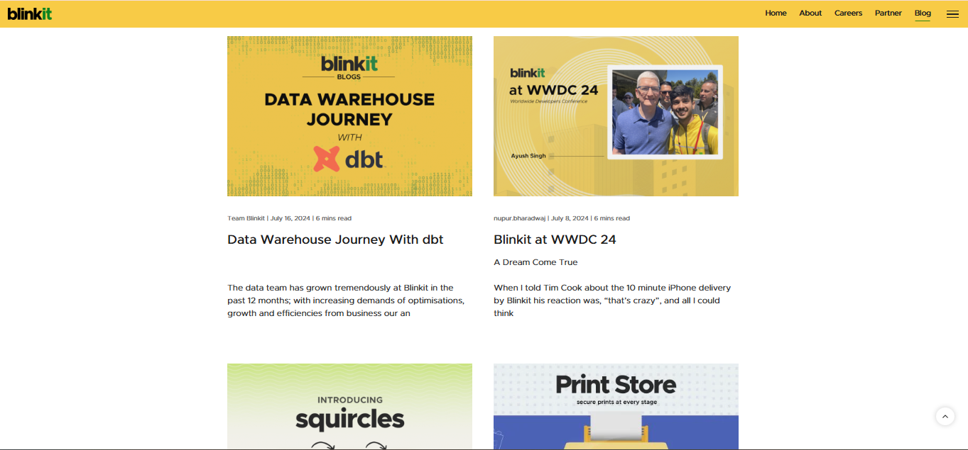
BLOGE PAGE

Slide 5
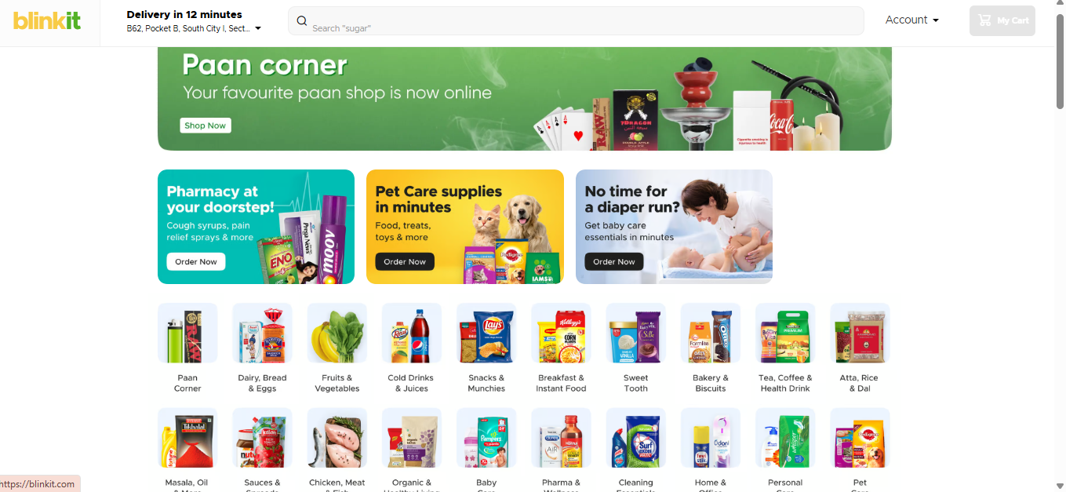
PRODUCT PAGE

Slide 6
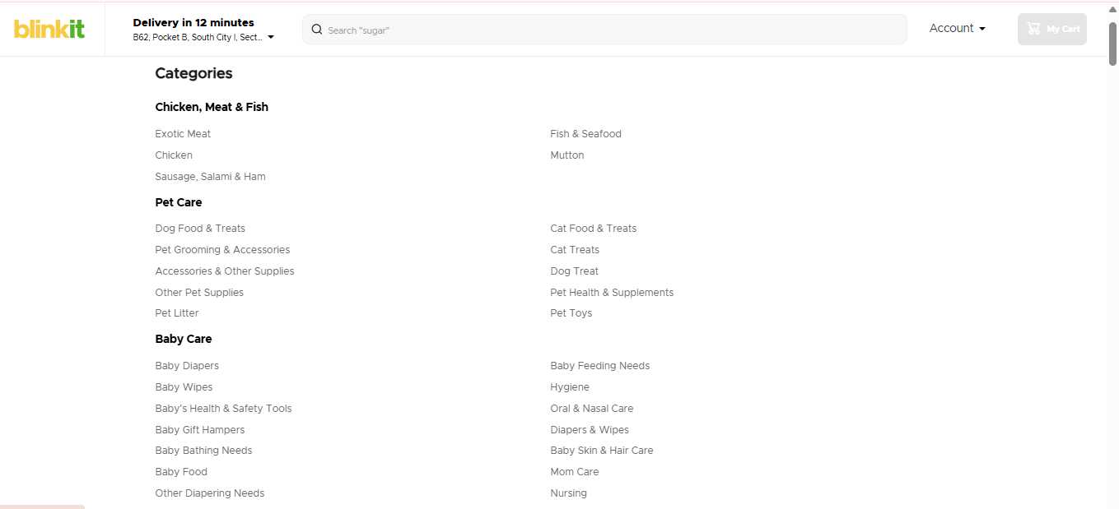
CATEGORIES PAGE

Slide 7
Content Structure
Blog Page
Product Page
Hero Title + Intro
Featured Blogs (Top 3 posts)
Categories (Groceries, Recipes, Lifestyle, Health)
Recent Posts List
Subscribe CTA
Footer Links
Product Title + Price + Delivery Time
Images
Highlights / Benefits
Description + Nutrition Info
Customer Reviews
Related Products
Add to Cart / Buy Now CTA

Slide 8
Content Structure
Category Page
Category Title + Short Intro
Filters & Sorting Options
Product Grid (image, price, add to cart)
Promo Banner
Info Section (about category)
Shop Now CTA

Slide 9





Competitive Analysis
Swiggy Instamart
Zepto
Big Basket
Amazon Fresh
Flipkart Super Mart

Slide 10
Content Structure
Blog Page
Product Page
Blinkit blog
Grocery delivery tips
Quick recipes with Blinkit
Healthy grocery ideas
Instant grocery delivery guide
Online shopping hacks
Blinkit updates
Daily essentials blog
Time-saving grocery shopping
Food and lifestyle tips
Buy milk online
Fresh milk delivery
Amul milk price
Mother Dairy milk online
Toned milk 1L
Dairy products near me
Blinkit milk delivery
Order milk now
Milk for tea and coffee
10-minute milk delivery

Slide 11
Content Structure
Category Page
Milk and dairy products
Buy dairy online
Fresh milk near me
Best milk brands
Online grocery delivery
Instant dairy delivery
Organic milk online
Blinkit groceries
Buy milk packets online
Daily essentials delivery

Slide 12
On-page Elements
1. Title Tag
2. Meta Description
3. URL Structure
4. H1 Tag
5. Image Alt Tags
6. Internal Linking
7. Content Optimization
8. Schema Markup
9. Mobile Optimization
10. CTA (Call to Action)

Slide 13
Example Blog
Healthy Breakfast Ideas – Quick & Easy with Flinkit
Starting your day with a healthy breakfast is essential for energy, focus, and overall well-being. Flinkit makes it easy to prepare nutritious meals at home by delivering fresh groceries straight to your doorstep in minutes. With Flinkit’s wide range of products, you can whip up quick breakfast recipes like fruit smoothies, oats porridge, or a wholesome egg sandwich without worrying about running to the store.
For a wholesome morning, try using fresh fruits, milk, oats, and eggs from Flinkit. A banana-oat smoothie with honey and almond milk is not only delicious but also packed with vitamins and protein. Similarly, a quick vegetable omelet or poha with fresh vegetables can be prepared in less than 15 minutes, giving you a balanced start to the day.

Slide 14
Example Blog
Healthy Breakfast Ideas – Quick & Easy with Flinkit
Flinkit’s instant delivery ensures you never run out of essentials. Whether it’s bread, eggs, milk, or seasonal fruits, Flinkit has all your breakfast needs covered. Plus, their app provides easy browsing, quick checkout, and real-time delivery tracking, making your morning routine stress-free.
By exploring Flinkit’s blog, you can discover more quick and healthy breakfast ideas, tips for meal prep, and insights on selecting the best groceries online. Start your mornings right with Flinkit, save time, and enjoy nutritious meals with your family.

Slide 15
On-Page Elements
Title Tag
Keywords
Meta Description
Image Alt Tags
H1 Tag
CTA
Internal Links

Slide 16
THANK YOU

